Slide 1
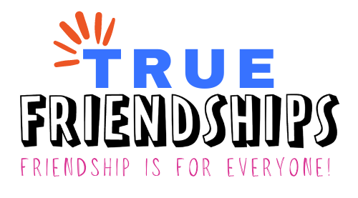
WELCOME!
Communication = Connection:
Tips for Communicating with Friends
This project is funded by the Pennsylvania Developmental Disabilities Council.

Slide 2
Special thanks to the Pennsylvania Developmental Disabilities Council for funding this project!

Slide 3
Learning Session Agenda
Background and Introductions
What is Communication?
Starting with the Person
The Many Ways We Communicate
Less is More
Tips and Tricks
Tool Time!

Slide 4
Introductions

Slide 5
True Friendships – Purpose
About True Friendships Project:
True Friendships hopes to make is easier for people with disabilities to make and keep friendships. The True Friendships project is focused on creating opportunity and capacity for friendships for all.
Notes:
The PA Developmental Disabilities Council is funding the Authentic Friendships grant and awarded it to Values Into Action, our project is called True Friendships. Our purpose is to help people create opportunities and capacity for friendships. We are especially focusing on assisting people with disabilities, by listening to the challenges and barriers they have faced in locating opportunities to create friendship and then developing learning sessions based on the feedback we received. The Learning sessions will begin in early 2024.

Slide 6
True Friendships– Project Partners
Temple University, Institute on Disabilities
Disability Pride PA
PA’s Education for All Coalition, Inc. – PEAC
Open Future Learning

Slide 7
Let’s Zoom!

Slide 8
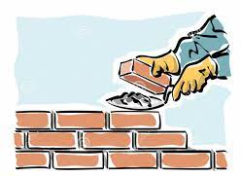
Why We are Here
Communication is the foundation for all human relationships. We use communication as a tool to share with others, understand, resolve conflicts, collaborate and build warm and trusting relationships.

Slide 9
What is Communication?
Communication is…
A two-way street
It requires us to receive and express:
Information
Feelings
Experiences

Slide 10
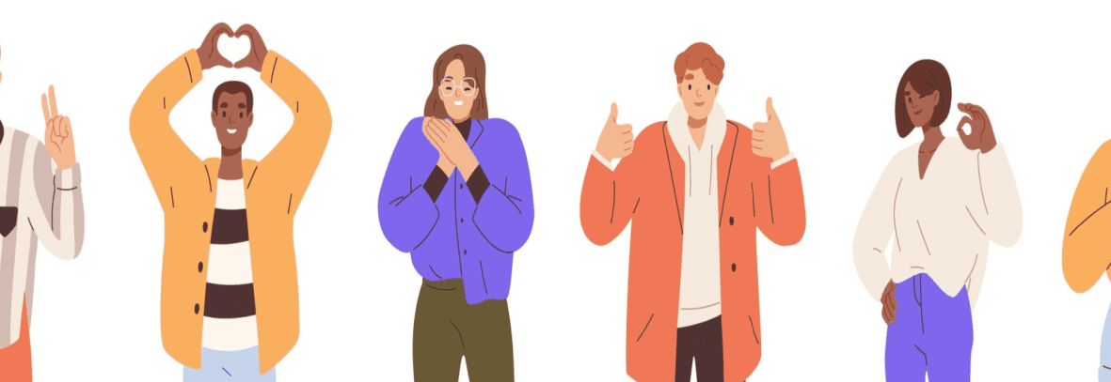
What is Communication?1
Communication is…
More than just words
Gestures (Pointing, signing, movement)
Facial expressions
Objects (Pictures, symbols, sound boards, and more)
Behavior

Slide 11
What is Communication?2
Communication is…
A human right!
It is a right to be able to influence what happens in your life, and that is done through communicating your wants and needs
It is a right to be communicated with in a way that is meaningful to you.

Slide 12
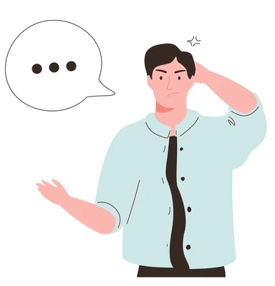
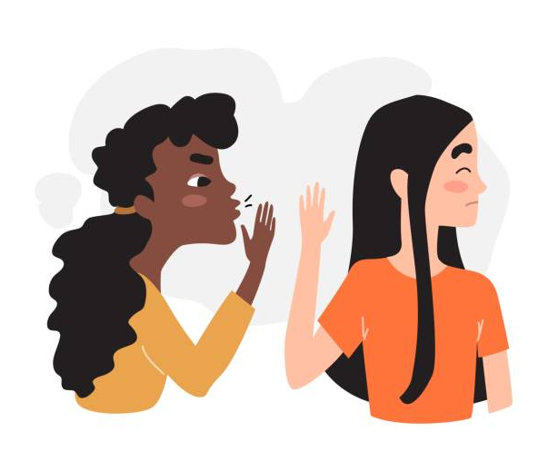
Barriers to Communication
Common barriers to communication that people with disabilities experience:
Uncertainty about how to connect
Not being listened to
Not being given enough time
These barriers can be frustrating, and sometimes lead to a person giving up on trying to communicate.

Slide 13
Communication is a Process
Remember that communication is a skill and a process that grows with you.
It’s okay to mess up!

Slide 14
Guessing Game: What Feeling are They Feeling?

Slide 15
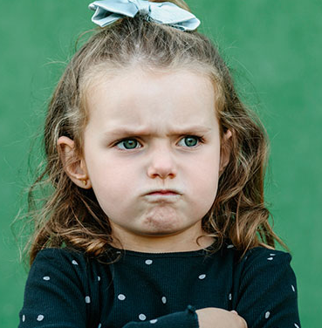
Guessing Game: What Feeling are They Feeling?1

Slide 16
Guessing Game: What Feeling are They Feeling?2

Slide 17
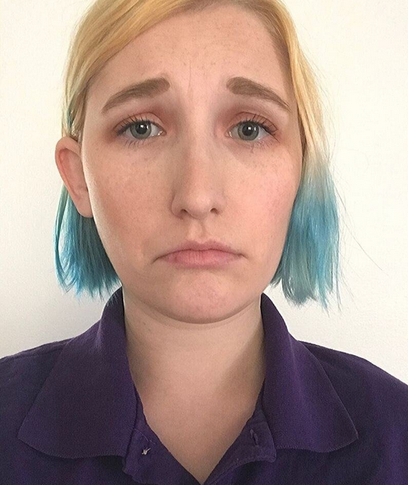
Guessing Game: What Feeling are They Feeling?3

Slide 18
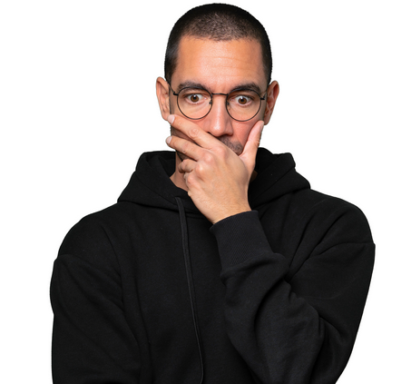
Guessing Game: What Feeling are They Feeling?4

Slide 19
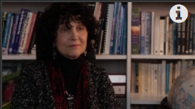
Start with the Person
Open Future Video: “Start with the Person” (2 minutes, 8 seconds)
“Listen slow with your whole body so that what I say will enter your heart.”
When we’re communicating, it’s best to Take it SLOW:
S: Share time with the person
L: Listen to the person
O: Observe what happens and try to make sense of it
W: Wait for a response. Give them time to communicate
Activity: Put in chat one word or phrase that spoke to you about this video.

Slide 20
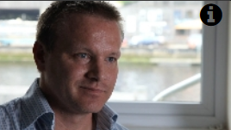
Less is More
Open Future Video: “Less is More” (1 minute, 55 seconds)
“Speak less, listen more.”
When we’re communicating, it’s important to:
Use plain language
Use receptive body language
Take your time, give your time

Slide 21
Tips for Communicating1
Remember: All of these can look different for everyone!
Give and Get Attention
Make sure you have their attention.
Make sure you are giving someone your attention when communicating.
Give and Get Feedback
If someone communicates to you in a way that doesn’t work for you, let them know!
If someone tells you that they need to be communicated with differently, take note.

Slide 22
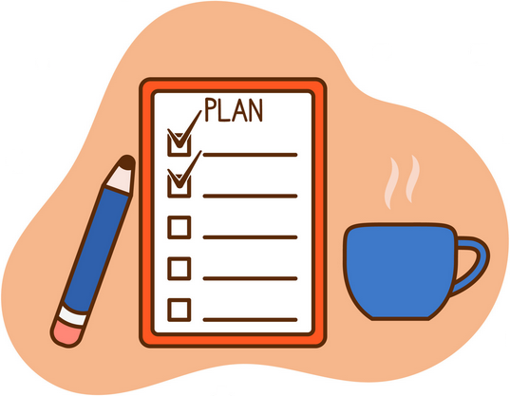
Tips for Communicating2
Remember: All of these can look different for everyone!
Plan Ahead When You Can
Worried about having to say something? Plan ahead! Write notes, scripts, whatever helps.
Don’t Make Assumptions
Not sure you understood what someone told you? Ask questions!

Slide 23
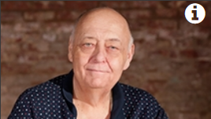
EVERYONE Can Communicate!
Open Future Video: “Communication Passport / Dictionary” (3 minute, 43 seconds)
“No matter how they are communicating, they are still communicating.”
Create a language dictionary so people know how to communicate with you or your family member.
Takes notes on how someone needs and wants to be communicated with.
Respect the language that people bring with them.

Slide 24
Tool Time: Communication Passport
A communication passport is a simple tool for explaining:
How a person communicates
How to communicate effectively with that person
That person’s likes and dislikes
Communication passports are a great tool for helping people understand one another.
These can be used in a variety of settings, and can be especially helpful when making new friends!

Slide 25
Communication Passport
My Communication Passport
My Name: Jolene | My Pronouns: She/Her
How I Communicate
Receptive | Expressive
Using multiple forms at once is best (ex: visuals and audio at the same time). Make sure you have my attention, or I might not take everything in. Just because I’m not looking at you doesn’t mean I’m not listening to you. Be patient with me; I need time to process what you tell me. Be clear in the instructions that you give me. I have spatial awareness problems. | Be patient with me; I need time to gather my thoughts and retrieve my words. Writing my thoughts makes it easier to express myself. What’s on my face isn’t always what I’m feeling inside. Sometimes my tone of voice doesn’t match what I am feeling. Sometimes I don’t notice the volume of my voice. Sometimes I accidentally say things that can hurt people’s feelings.
How You Can Support Me
Please Do | Please Don’t
Don’t take everything I say that offends you personally. Tell me if I hurt your feelings, and explain how. If I don’t know how, I can’t change anything. Assume competence, and respect if I say I cannot do something. | Talk down to me. Tell me things if you don’t want them repeated – I always like to tell the truth. Tell me how to live my life. Finish my sentences or speak for me.

Slide 26
Communication Passport2
Preferences and Topics
Things I Like | How I Communicate I Like Them
Tv shows/movies Animals Dog parents/hearing about people’s dogs Dolly Parton Graphic novels Events I can go to Instagram posts that I like Junk food My job Music I like | I smile when people bring these things up. I like to discuss them. I like to spend more time with people who share my interests.
Things I Don’t Like | How I Communicate My Boundaries
People talking negatively about my family. People who are unkind to animals. People assuming I can’t speak. Willful ignorance. My boundaries not being respected. People who are mean to people who are different from them. | I will tell you directly. I will distance myself from the person or situation.

Slide 27
Questions?

Slide 28
Upcoming Events
Technical Assistance Sessions
For self-advocates / family members:
Wednesday, Feb 21 at 6:30pm
For professionals:
Thursday, Feb 29 at 10:00am
More Learning Sessions
Coming later in 2024
Topics that will be covered:
Safety: Myths and Reality
Relationships: Healthy vs Toxic
Sustaining Friendships

Slide 29
Thank you!
True Friendships Contacts
Project email – AuthenticFriendships@viapa.org
Robert Zotynia, Self-Advocate Advisor,
Co-coordinator of Project Advisory Workgroup
RZotynia@gmail.com
Jamie Lisberger, Self-Advocate Advisor,
Co-coordinator of Project Advisory Workgroup
Tina Steinbacher, Co-coordinator of Project Advisory Workgroup
KristinaS@viapa.org
Alex Brosseau, Grants and Initiatives Project Coordinator
AlexB@viapa.org
Amy Jedele, Project Director
AmyJ@viapa.org

