Slide 1
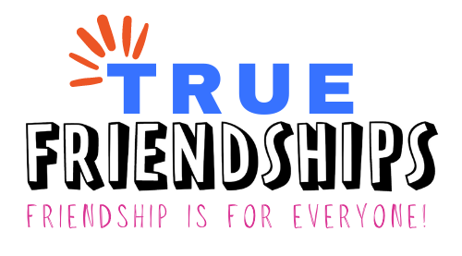
WELCOME!
Making New Friends Safely

Slide 2
Special thanks to the Pennsylvania Developmental Disabilities Council for funding this project!

Slide 3
True Friendships– Project Partners
Temple University, Institute on Disabilities
Disability Pride PA
PA’s Education for All Coalition, Inc. – PEAC
Open Future Learning

Slide 4
True Friendships – Purpose
About True Friendships Project:
True Friendships hopes to make is easier for people with disabilities to make and keep friendships. The True Friendships project is focused on creating opportunity and capacity for friendships for all.
Notes:
The PA Developmental Disabilities Council is funding the Authentic Friendships grant and awarded it to Values Into Action, our project is called True Friendships. Our purpose is to help people create opportunities and capacity for friendships. We are especially focusing on assisting people with disabilities, by listening to the challenges and barriers they have faced in locating opportunities to create friendship and then developing learning sessions based on the feedback we received. The Learning sessions will begin in early 2024.

Slide 5
Let’s Zoom!

Slide 6
Learning Session Agenda
Background and Introductions
What does friendship look like?
How does structure help us find friends?
Planning your friendship journey
Ways to find people
Tips for staying safe when meeting new people

Slide 7
Introductions

Slide 8
Why We are Here
Meeting new people can be hard, and sometimes scary. But it doesn’t have to be!
We can create safety by drawing on lessons from past experiences and planning for our friendship journeys.
Everyone’s journey is unique; make it your own!
Notes:
[Alex] I was really excited to talk about this topic because it’s one that is especially relevant to me and my life. I’m from Arizona originally, which is on the other side of the country from us. When I got here, I was very worried about how I was going to make friends. I didn’t know anyone here, I had no friends within 2 hours distance of me, and I had no idea how I was going to start fresh in this whole new world. It would have been weird if I just went and introduced myself to everyone and asked them to be my friend. So I had to think about how I could create structure for myself without having many connections. Today, we’re going to be focusing a lot on how we can create structure for the process of making friends, and learn how that structure can help us stay safe as we make new friends. We’ll also talk about how to build safety into our plans.

Slide 9
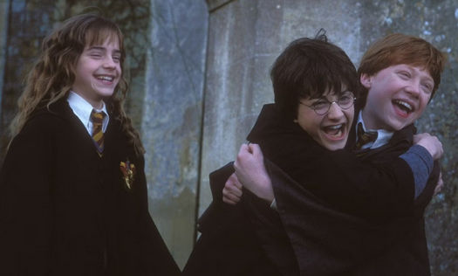
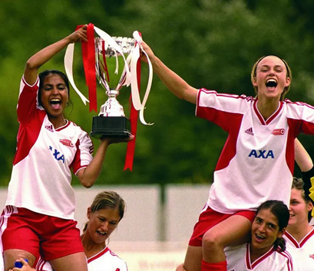
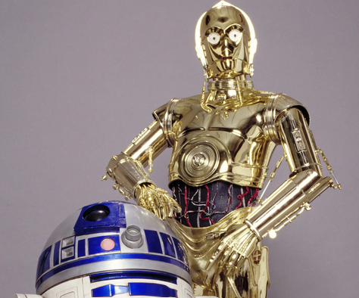
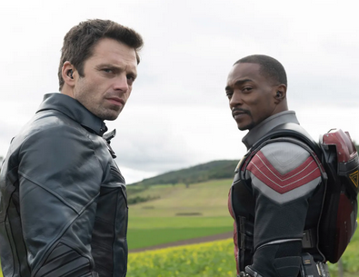
Step 1: What Does Friendship Look Like?
Friends are people who:
Spend time with you
Support you
Do fun things with you
Share similar interests and beliefs as you
Make you feel happy
Make you feel safe
Tell us! Who is someone in your life that makes you feel happy and safe?
Notes:
It’s impossible to achieve any kind of goal if you’re not sure how to define it. So the first step on your friendship journey is to first think about what friendship should look like for you. To start us off, we’ve got some pictures here of some friends we’ve seen in movies and on TV that give us a starting idea of what friendship looks like.

Slide 10
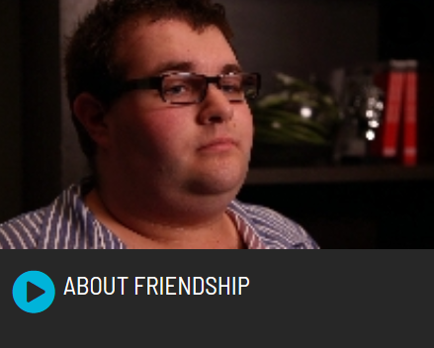
What Friendship Means to YOU
Open Future Video: Friendship Defined/About Friendship (55 seconds), Steve Dymond explains what friendship means to him.
Tell Us! What does friendship mean to you?

Slide 11
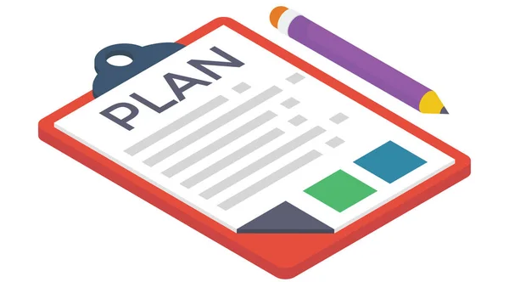
Why is Structure Important?
Structure in your friendship journey can be helpful and keep you safe in a lot of ways. It can:
Remind you of your goals.
Help you remember what you want to avoid.
Remind you that you have a plan and you can make it happen!
Notes:
A good amount of this session will be focused on using tools to create structure for your friendship journey. Structure is awesome for a lot of reasons. It can help us know what we’re going to do with out days, plan out what we’re going to do, and give us a sense of control when we otherwise might not feel like we are in control of what’s happening around us. Friendship is no exception to that rule. Structure creates safety for us in a couple ways:
It helps us remember what our goals are and keeps us on track to achieve them.
It allows us to notice when we’re drifting away from our original goals.
It can give us the confidence that we know what we’re looking for, we know what we’re doing, and we are capable of achieving the goals we set for ourselves.

Slide 12
Step 2: Painting Your Friendship Picture
Charting the LifeCourse:
Life Trajectory Planning Tool
Can be used to help envision what you want from your friendships.
Can do by yourself or with someone’s support.
Don’t have to do it all at once! You can think about the questions and come back to it.
Notes:
We’ve started thinking about what we want our friendships to look like, and thought about some people in our lives that give us an idea of what we want those connections to look like.

Slide 13
Step 2: Good Life Vision

Slide 14
Step 2: What to Avoid in the Future

Slide 15
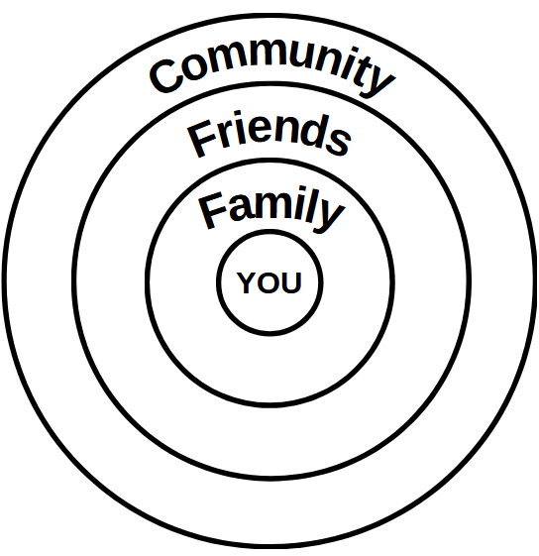
Step 3: Find Your People Through Others
Use existing connections
Meeting others through people you already trust can be safer and easier.
Think about who you already know who has connections in the community.
Ask people you trust for recommendations.
Tell Us! Is there someone in your life that might be able to help you make new connections? Who is that person?

Slide 16
Step 3: Find Your People in New Places
Starting from scratch
Decide what is safe for you.
Look for places with people who share your interests. Get creative!
Find out what’s going on in your community
Libraries
Community gardens
Animal park/daycare
Comic book shops
Tell Us! Where are some places you could meet new people?

Slide 17
Tips for Staying Safe on Your Friendship Journey
Staying Safe In Person
Meet new people in public places
Make sure someone knows where you’re going
For events, look into who/what organization is hosting them
Use the buddy system
Staying Safe Online
Watch out for fake profiles
If someone is sending you messages that make you feel unsafe, you can block them
If you’re not sure if someone or a website is safe, ask someone you trust
These are some general tips, but you need to decide what works best for you.
You can find more tips in our Relationship Resource Guide!

Slide 18
Questions?

Slide 19
Upcoming Events
Technical Assistance Sessions
For self-advocates / family members:
Wednesday, June 12th, 6:00pm – 7:00 pm
For professionals:
Thursday, June 20th, 10:00 am – 11:00 am
More Learning Sessions
Coming later in 2024
Topics that will be covered:
Relationships: Healthy vs Unhealthy
Sustaining Friendships

Slide 20
Thank you!
True Friendships Contacts
Project email – AuthenticFriendships@viapa.org
Robert Zotynia, Self-Advocate Advisor,
Co-coordinator of Project Advisory Workgroup
RZotynia@gmail.com
Jamie Lisberger, Self-Advocate Advisor,
Co-coordinator of Project Advisory Workgroup
Tina Steinbacher, Co-coordinator of Project Advisory Workgroup
KristinaS@viapa.org
Alex Brosseau, Grants and Initiatives Project Coordinator
AlexB@viapa.org
Amy Jedele, Project Director
AmyJ@viapa.org

