Slide 1
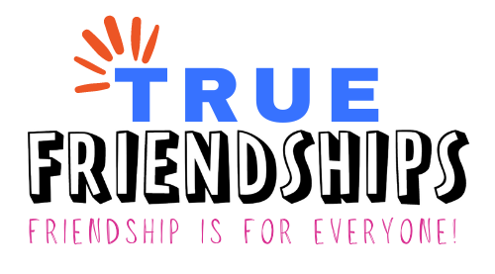
WELCOME!
Healthy Friendships and YOU

Slide 2
Special thanks to the Pennsylvania Developmental Disabilities Council for funding this project!

Slide 3
True Friendships– Project Partners
Temple University, Institute on Disabilities
Disability Pride PA
PA’s Education for All Coalition, Inc. – PEAC
Open Future Learning

Slide 4
True Friendships – Purpose
About True Friendships Project:
True Friendships hopes to make is easier for people with disabilities to make and keep friendships. The True Friendships project is focused on creating opportunity and capacity for friendships for all.
Notes:
The PA Developmental Disabilities Council is funding the Authentic Friendships grant and awarded it to Values Into Action, our project is called True Friendships. Our purpose is to help people create opportunities and capacity for friendships. We are especially focusing on assisting people with disabilities, by listening to the challenges and barriers they have faced in locating opportunities to create friendship and then developing learning sessions based on the feedback we received. The Learning sessions will begin in early 2024.

Slide 5
Let’s Zoom!

Slide 6
Introductions

Slide 7
Learning Session Agenda
Background and Introductions
What is a healthy friendship?
Boundaries
Mistakes and Conflict Are Not Always Bad
Letting Go of Unhealthy Friendships

Slide 8
Why We are Here
It’s important to know what healthy friendships are.
You don’t have to have experience with friends to know what a healthy friendship can look like.
Even though friendships can get complicated, it doesn’t mean they’re unhealthy.
When a friendship is unhealthy, it’s okay to let it go.

Slide 9
What Makes a Friendship Healthy?
Building blocks of a healthy friendship:
Respect
Good communication
Shared interests
Feeling good with the person
Supporting each other
Notes:
It’s impossible to achieve any kind of goal if you’re not sure how to define it. So the first step on your friendship journey is to first think about what friendship should look like for you. To start us off, we’ve got some pictures here of some friends we’ve seen in movies and on TV that give us a starting idea of what friendship looks like.

Slide 10
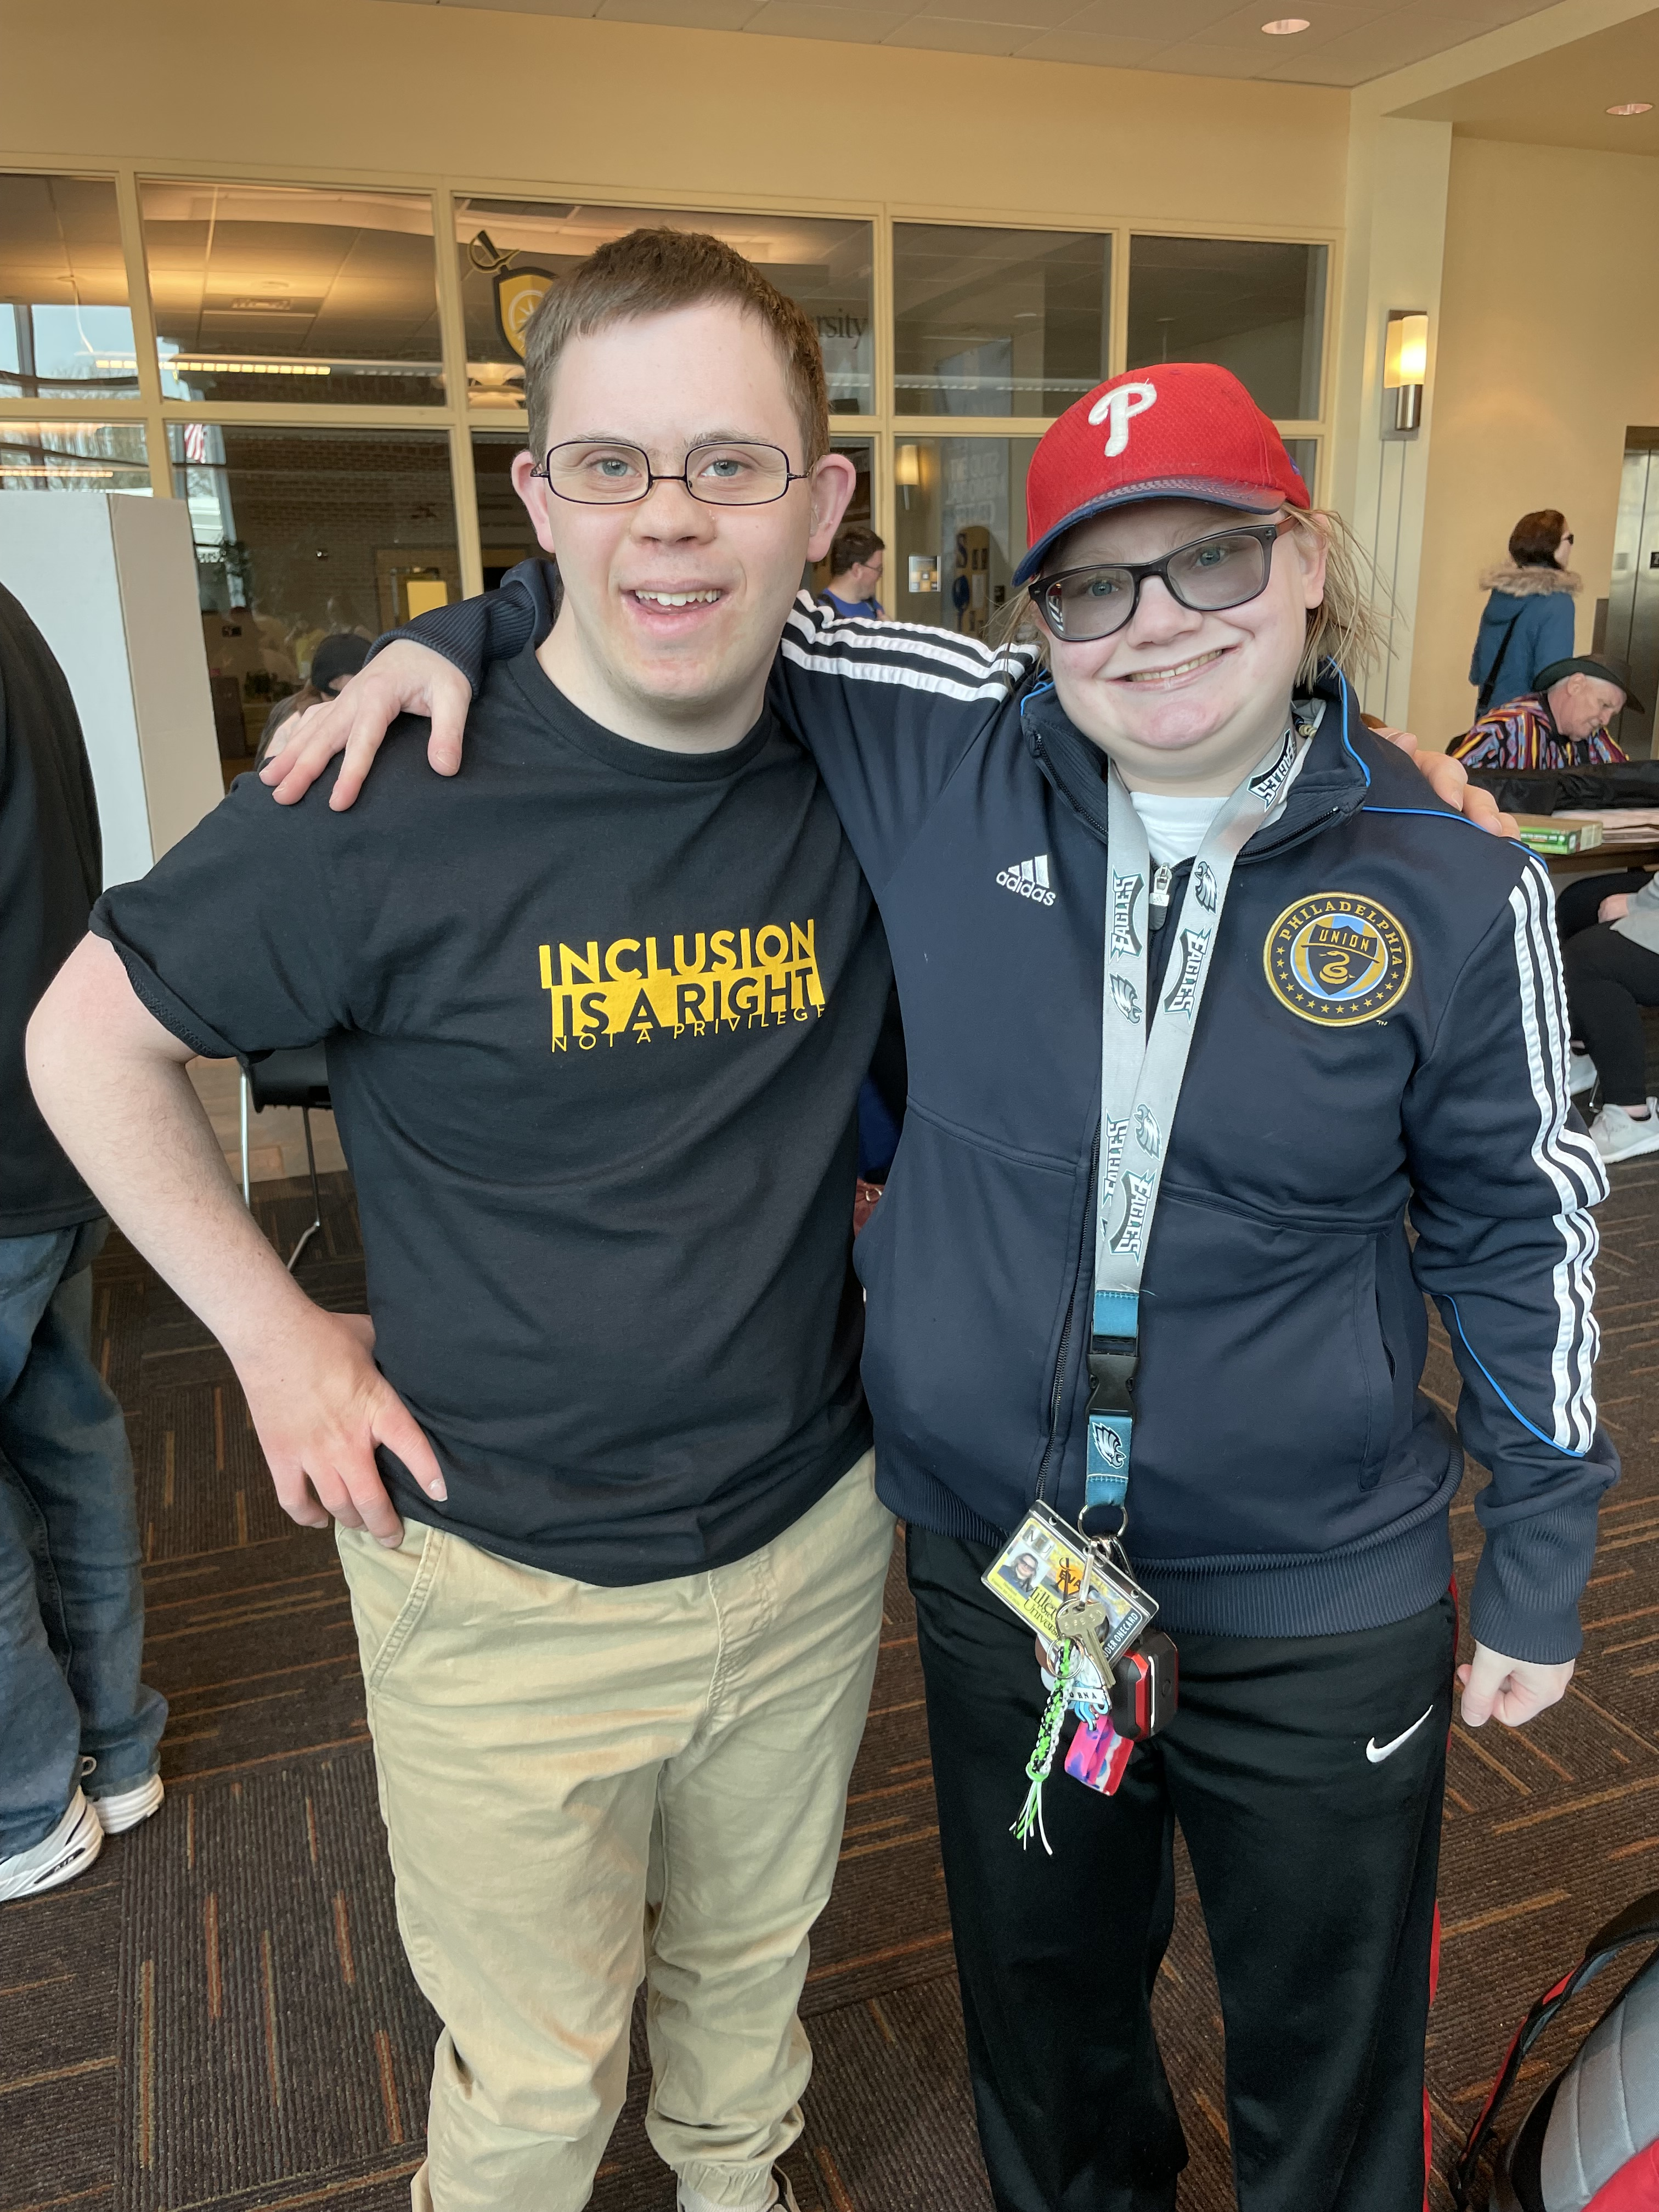
Chris and Lorna
I have a friend named Lorna. Lorna went to Millersville University with me majoring in Integrated Studies.
We like to do things together. We took an Uber, then we went to the mall to have some food with some conversation with her. I invited my friends including her to the Sugar Bowl restaurant. I also text her. We also went to the Galley dining hall in college. We like to talk about how classes are doing including her major, social justice.
I like many things about Lorna. She likes her social justice major. I minor in social justice as well. She cares about people doing the right things. She is very comfortable with them. I really like that about her.
Notes:
It’s impossible to achieve any kind of goal if you’re not sure how to define it. So the first step on your friendship journey is to first think about what friendship should look like for you. To start us off, we’ve got some pictures here of some friends we’ve seen in movies and on TV that give us a starting idea of what friendship looks like.

Slide 11
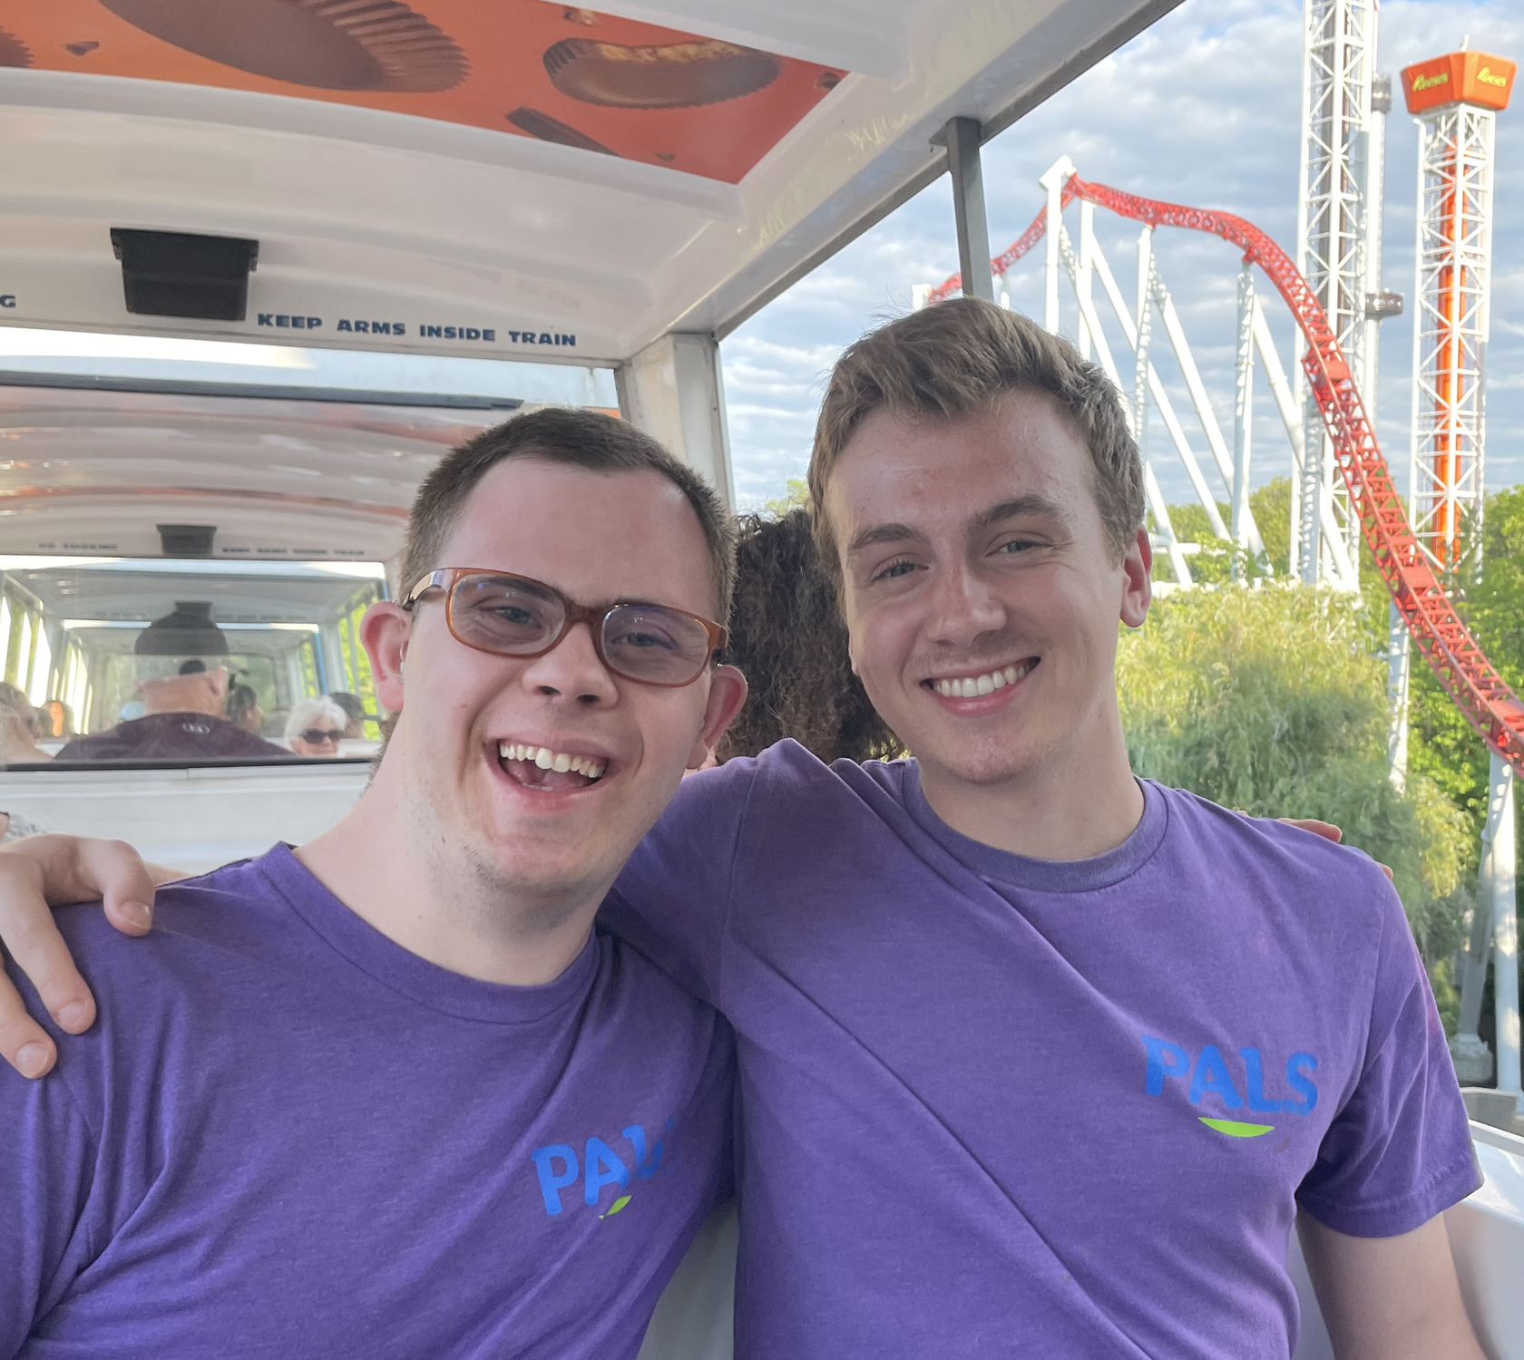
Chris and Timmy
I have a friend Timmy. We respect each other. I go see him while he is performing. I invited Timmy to go to Camp Pals with me a whole week, so he came. We like to have matching shirts in Hershey Park every summer. Timmy wanted to go see the animals at the Farm Show Complex, so I agreed.
I know Timmy respects me, because he shows me he respects me. I like hearing my friends singing songs on Instagram. I asked him to do it with me. He was tired after a long day, but we made it work when we got back home. He recorded both of us singing then showed me how to post it on Instagram. Timmy made me feel very happy.
I also show Timmy that I respect him. We have different spiritual beliefs. I go to his church every once in a while. I am friendly to them. I am thinking about maybe if I believe what they teach there too.
Notes:
It’s impossible to achieve any kind of goal if you’re not sure how to define it. So the first step on your friendship journey is to first think about what friendship should look like for you. To start us off, we’ve got some pictures here of some friends we’ve seen in movies and on TV that give us a starting idea of what friendship looks like.

Slide 12
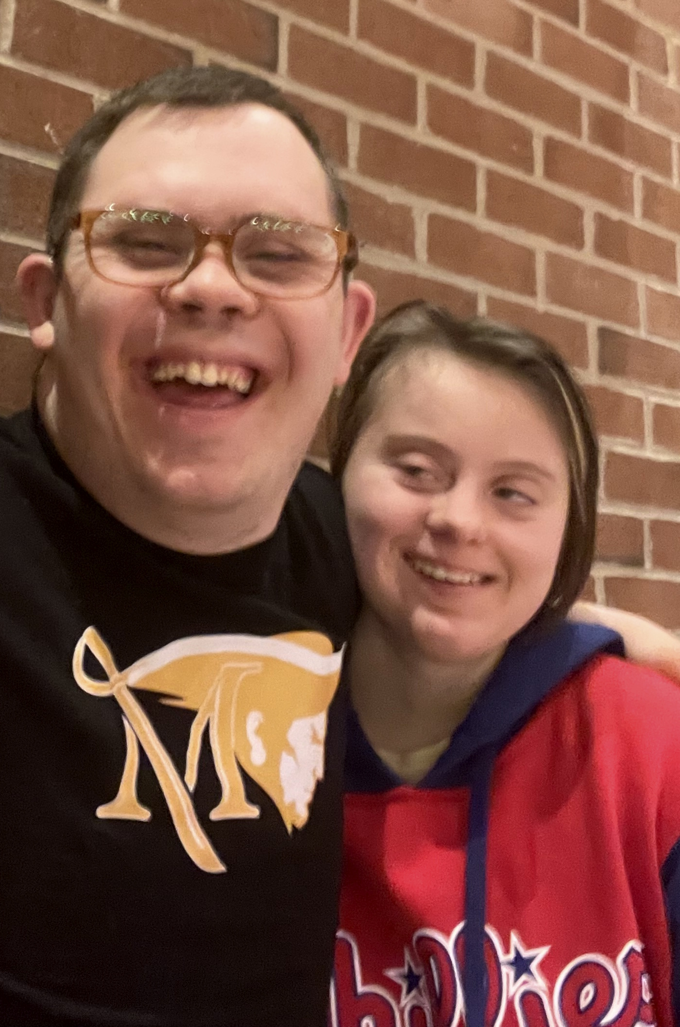
Chris and Hayley
My friends show me they support me in many ways. My friend Hayley from Millersville tells me how she appreciates me as a friend. She includes me in activities she is doing.
I also do things to show Hayley I support her. I went to my friend Hayley’s PATH. PATH is a group planning tool to reach your major goals. I joined the group in suggesting ideas for her to reach her goals. I attended her graduation celebration. I invited her to the Sugar Bowl restaurant to celebrate. I encourage her when she feels sad about leaving Millersville University.
Notes:
It’s impossible to achieve any kind of goal if you’re not sure how to define it. So the first step on your friendship journey is to first think about what friendship should look like for you. To start us off, we’ve got some pictures here of some friends we’ve seen in movies and on TV that give us a starting idea of what friendship looks like.

Slide 13
Tell us!
Tell Us! What does a healthy friendship mean to you?
Notes:
It’s impossible to achieve any kind of goal if you’re not sure how to define it. So the first step on your friendship journey is to first think about what friendship should look like for you. To start us off, we’ve got some pictures here of some friends we’ve seen in movies and on TV that give us a starting idea of what friendship looks like.

Slide 14
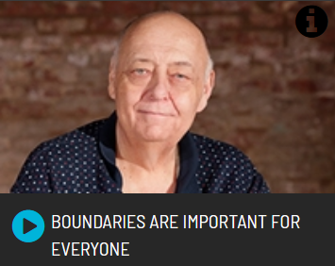
Open Future Video: Boundaries are Important for Everyone
Key Points:
Everyone should be allowed to set their own boundaries.
Boundaries can help you decide what is safe and how to deal with unsafe moments before they happen.
Tell Us! Why are boundaries important to you?

Slide 15
What are Boundaries?
Boundaries are:
Limits we set to protect our comfort, safety, and well-being.
They show what is okay and not okay in our relationships.
Boundaries help make sure we respect and understand each other.
YOU get to decide what your boundaries are!

Slide 16
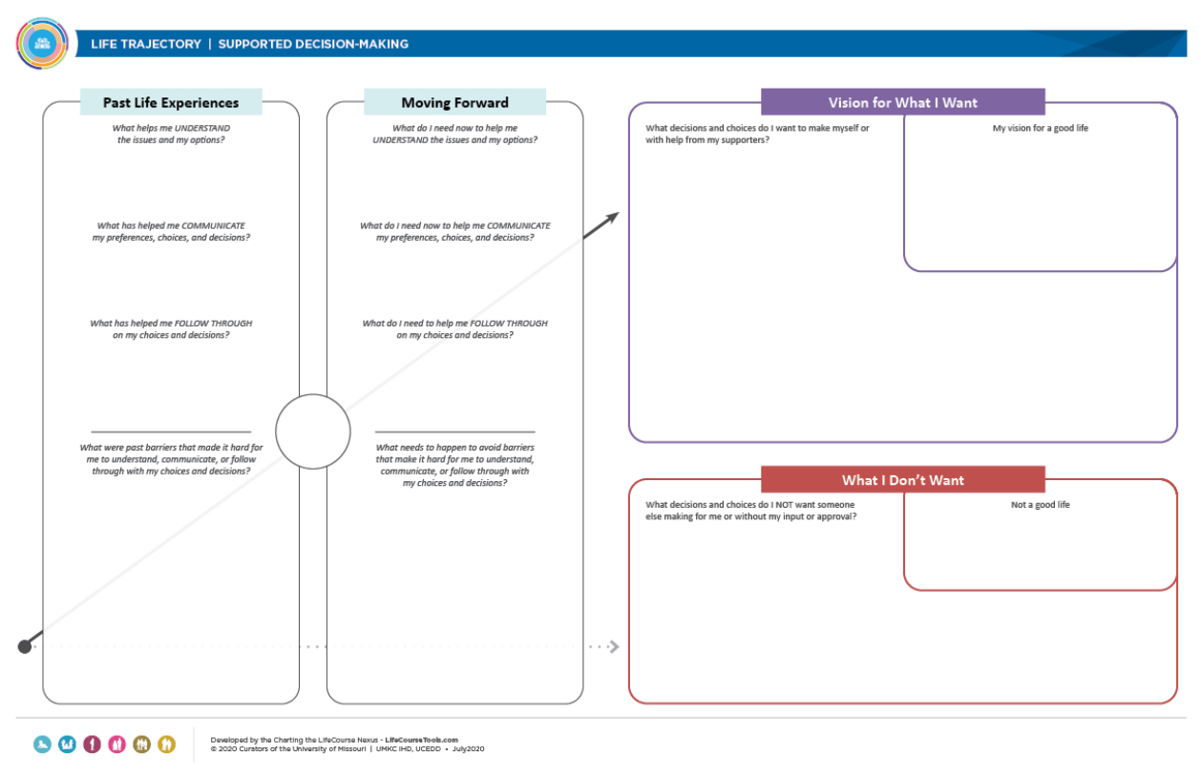
Deciding What Your Boundaries Are
Think about what makes you feel comfortable and safe.
Identify what situations and behaviors you like or don’t like.
Use tools like Charting the LifeCourse to help you remember what your boundaries are.

Slide 17
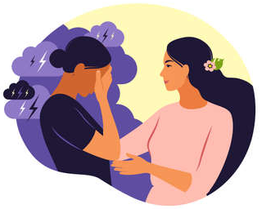
Mistakes and Conflict Aren’t Always Bad
Mistakes and Conflict are Natural
Everyone makes mistakes, and that’s okay.
Talking about problems helps friendships grow.
Learning from mistakes makes friendships stronger.

Slide 18
What to Do When Mistakes Happen
When you make a mistake…
Take responsibility and apologize.
Ask your friend how you can make it right.
Learn from the experience and try not to repeat the mistake.
When someone else makes a mistake…
Tell your friend how their actions affected you.
Give them a chance to apologize and make it right.
Decide if you can forgive them and move forward together.
Remember, it’s okay for both of you to take time to process.
Tell Us! How do you deal with mistakes when they happen?

Slide 19
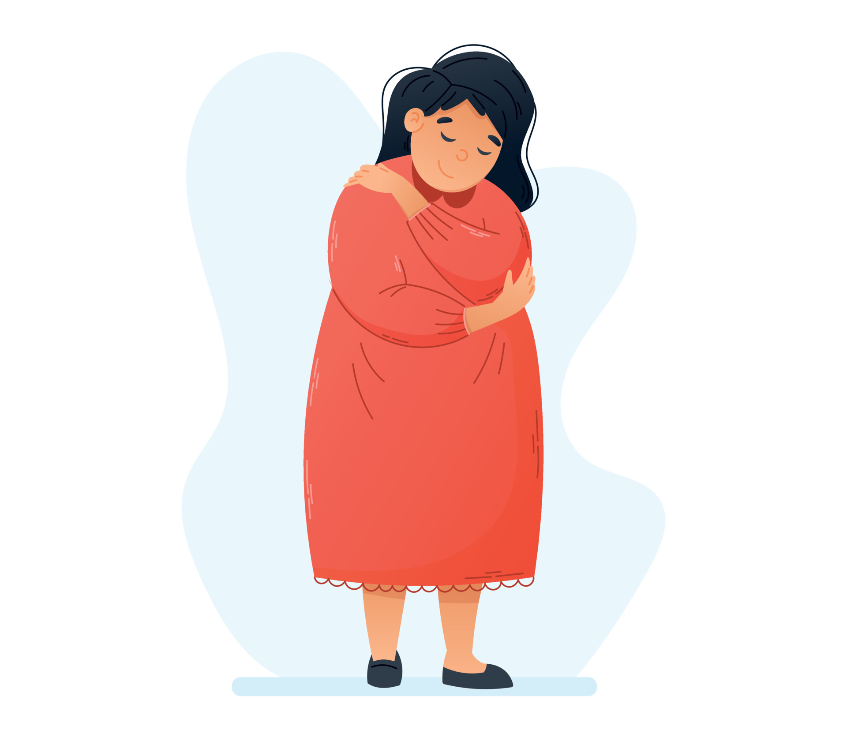
Letting Go of Unhealthy Friendships
Recognize when a friendship is unhealthy. You might feel:
Unhappy
Disrespected
Unsafe
If you have to break up with a friend…
Be honest, kind, and clear about why the friendship is ending.
Give yourself time to process your feelings.
Remember: Ending one friendship doesn’t mean you will never have a friend again.

Slide 20
Questions?

Slide 21
Upcoming Events
Technical Assistance Sessions
For self-advocates / family members:
Wednesday, September 11th,
6:00pm – 7:00 pm
For professionals:
Thursday, September 26th,
10:00 am – 11:00 am
Next Learning Sessions:
Topic: Sustaining Friendships
Coming November 2024

Slide 22
Thank you!
True Friendships Contacts
Project email – AuthenticFriendships@viapa.org
Robert Zotynia, Self-Advocate Advisor,
Co-coordinator of Project Advisory Workgroup
RZotynia@gmail.com
Jamie Lisberger, Self-Advocate Advisor,
Co-coordinator of Project Advisory Workgroup
Tina Steinbacher, Co-coordinator of Project Advisory Workgroup
KristinaS@viapa.org
Alex Brosseau, Grants and Initiatives Project Coordinator
AlexB@viapa.org
Amy Jedele, Project Director
AmyJ@viapa.org

Slide 23
Thank You!

